Slide 1
Getting Started with Vault

Slide 2
Objectives
Know how to access Vault
Know how to request access to tenants and applications
Know how to request a SIPR Vault account

Slide 3
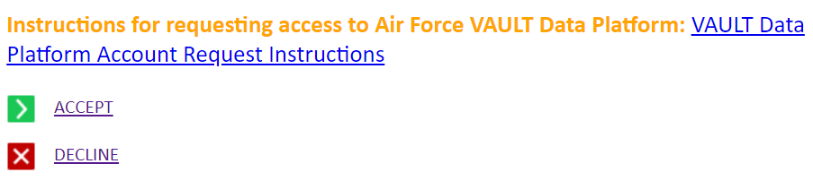
Reaching Landing Page
Navigate to https://afdatalab.af.mil
Scroll all the way down and hit “Accept”
When the pop-up appears choose your e-mail certificate

Slide 4
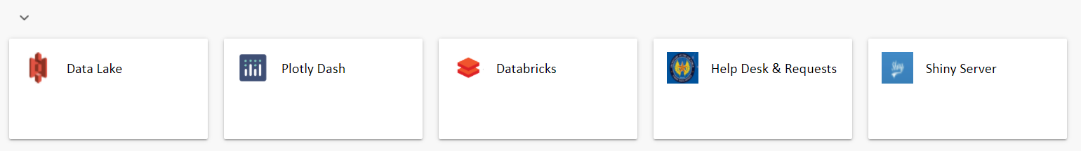
Requesting Access
Your landing page will be pretty empty at first
Need to request access to tenants to gain applications
On landing page click “Help Desk & Requests”
On the next page click “Access & Tenant Requests”

Slide 5
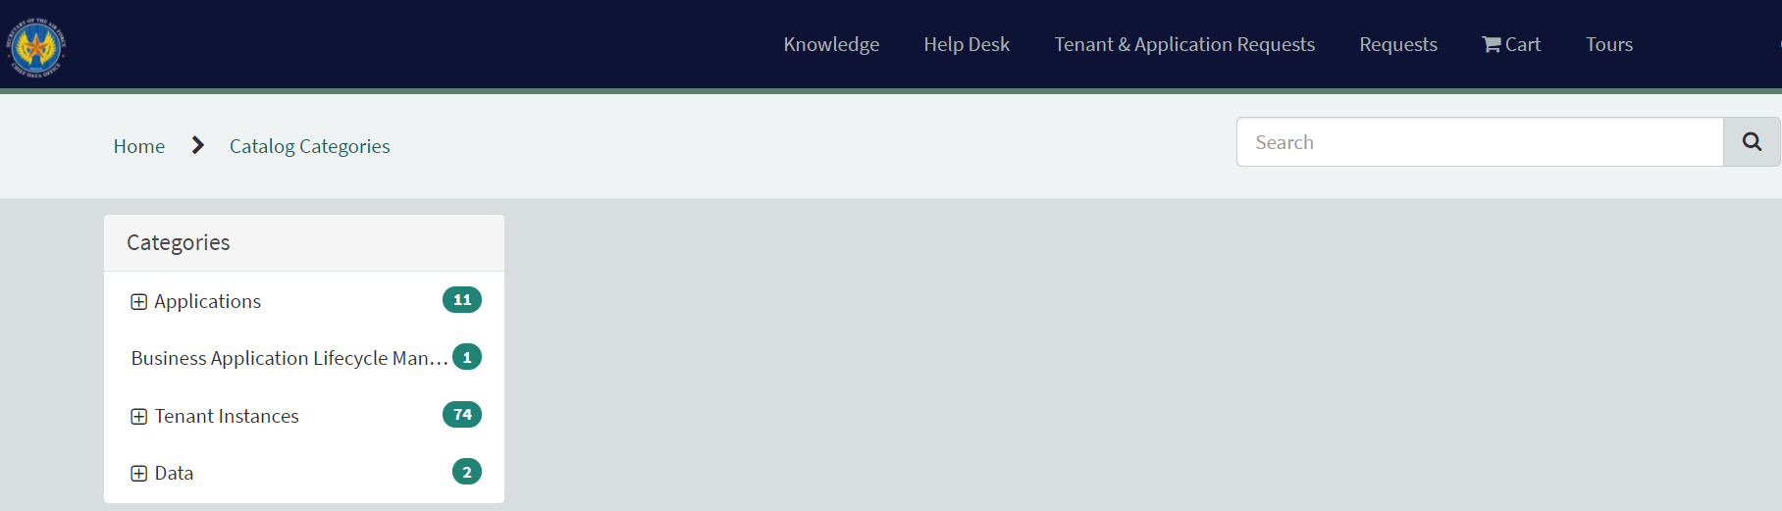
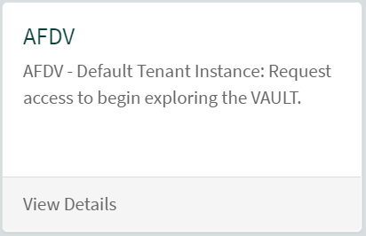
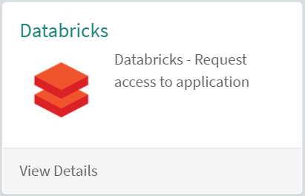
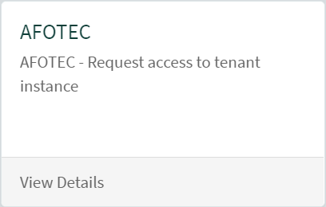
Obtaining Apps and Tenants
Select appropriate Category or use search bar
Request Databrick, AFDV, and AFOTEC
If you are a 15A, request AFAC tenant as well

Slide 6
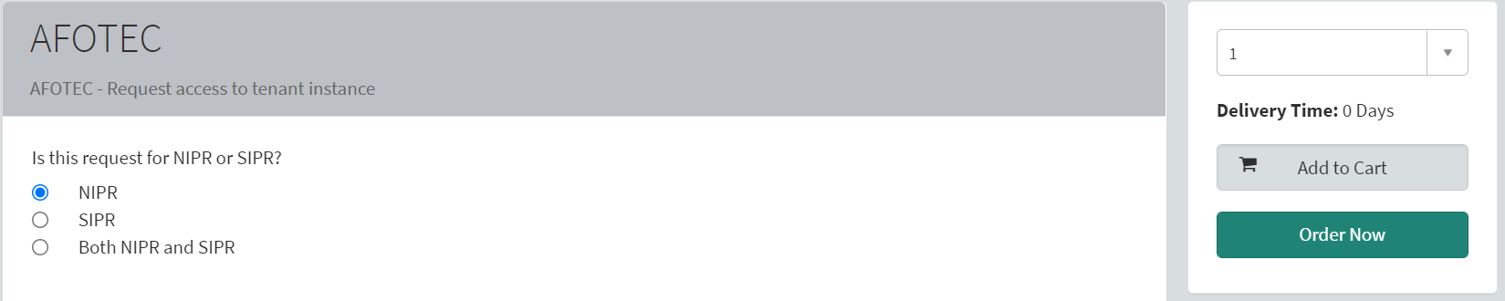
Adding to Cart
Selecting each instance will take you to a screen similar to below. Add it to your “cart”
Not all screens will ask if request is for both NIPR and SIPR

Slide 7
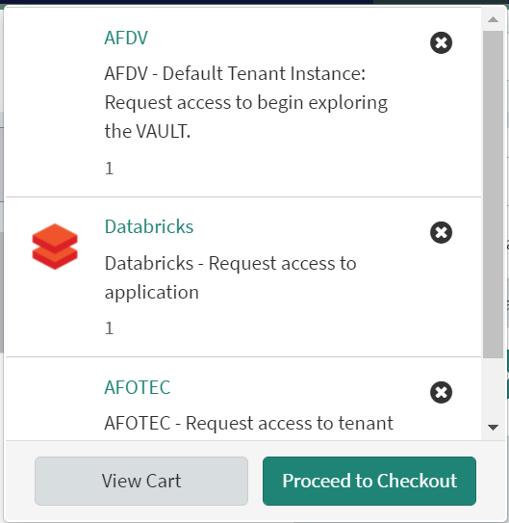
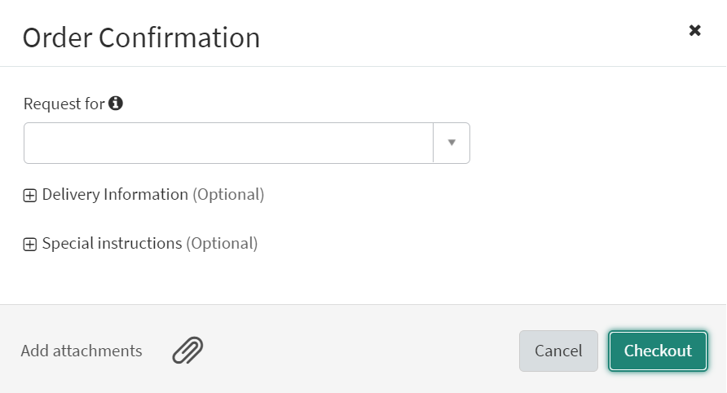
Checking Out
After adding all tenant instances and applications to your cart, “check out”

Slide 8

Help Desk
Click on “Help Desk”
Getting Vault on SIPR
Category = Accounts
Short description = Access to SIPR Vault (Tenant or App)
Description = Describe what you would like access to on SIPR, and include both your SIPR email and DoD ID #
Accessing AFOTEC clusters for Databricks
Category = General
Short description = Request AFOTEC cluster access
Description = Identify which clusters you need access to (NIPR/SIPR)

Slide 9
Advantages of Vault
Store your data securely via the AFOTEC Tenant (NIPR is PII capable, SIPR)
Use DoD datasets (growing all the time)
Import public data from the web to help in your analysis work
Free form ability to analyze
Import any package related to Python, R, Scala, Julia
Share your analysis from data in real time
Use other people's work, and improve on it
Official solution

Slide 10
Additional Resources
DataCamp
https://app.datacamp.com/learn
UDemy
https://www.udemy.com/topic/python/
https://www.udemy.com/topic/r-programming-language/
DigitalU
https://digitalu.af.mil/app
Google Python Course
https://developers.google.com/edu/python
Automate the Boring Stuff with Python
https://automatetheboringstuff.com/
MITx Computational Thinking using Python
https://www.edx.org/xseries/mitx-computational-thinking-using-python

